Slide 1
For Fun

Slide 2
Instructions
Divide class into 4 teams
One person from each team will come up to board, one at a time, to guess the price of the product on display
Alternate teams going up first each round
The team with the closest price, without going over, wins that round and earns 1 point
Team with most points wins

Slide 3
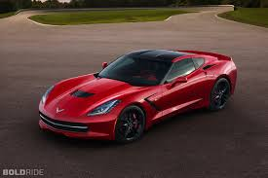
2014 Corvette Stingray

Slide 4
2014 Corvette Stingray Coupe
$53,000

Slide 5
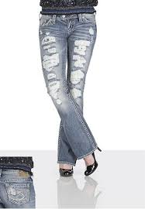
silver jeans co. ® suki destructed crochet skinny ankle jeans

Slide 6
silver jeans co. ® suki destructed crochet skinny ankle jeans
$98

Slide 7
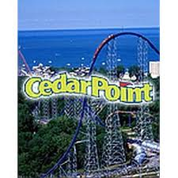
Cedar Point, Sandusky, OH. Single Day Adult Ticket at the Front Gate

Slide 8
Cedar Point, Sandusky, OH. Single Day Adult Ticket at the Front Gate
$59.99

Slide 9
Concert Tickets, Luke Bryan, Floor Seating, Madison Square Garden, NY

Slide 10
Concert Tickets, Luke Bryan, Floor Seating, Madison Square Garden, NY
$106.50

Slide 11
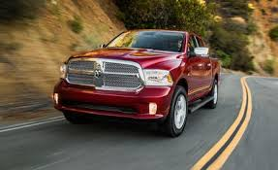
2014 RAM 1500 EcoDiesel

Slide 12
2014 RAM 1500 EcoDiesel
$36,475

Slide 13
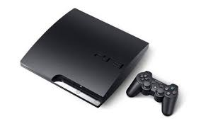
Sony PlayStation 3 - 120 GB - Charcoal Black

Slide 14
Sony PlayStation 3 - 120 GB - Charcoal Black (Ebay)
$850

Slide 15
Beats Studio - headset - Full size, Binaural - White

Slide 16
Beats Studio - headset - Full size, Binaural - White
$250

Slide 17
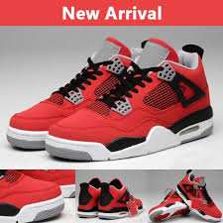
J4 Retro Basketball Shoes Popular J 4 Training shoes JD4 Sneakers Retro 4 Boots JR4 Sports Shoes

Slide 18
J4 Retro Basketball Shoes Popular J 4 Training shoes JD4 Sneakers Retro 4 Boots JR4 Sports Shoes
$55.88

Slide 19
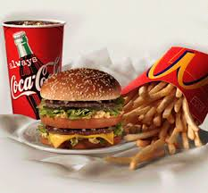
Big Mac Extra Value Meal Meal Include Medium French Fries and Soft Drink

Slide 20
Big Mac Extra Value Meal Meal Include Medium French Fries and Soft Drink
$5.69

Slide 21
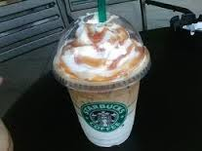
Caramel Macchiato from Starbucks (Venti)

Slide 22
Caramel Macchiato from Starbucks (Venti)
$4.65

Slide 23
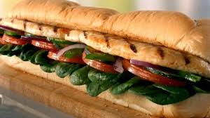
Oven Roasted Chicken Footlong Subway

Slide 24
Oven Roasted Chicken Footlong Subway
$6.00

Slide 25
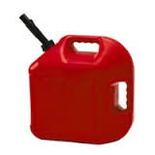
Gallon of Gas, Current Michigan Average

Slide 26
Gallon of Gas, Current Michigan Average
$3.53

